Slide 1
Hardening Android‘s Task Management to prevent Phishing
Mirko Meinerzag | 16.02.2022

Slide 2
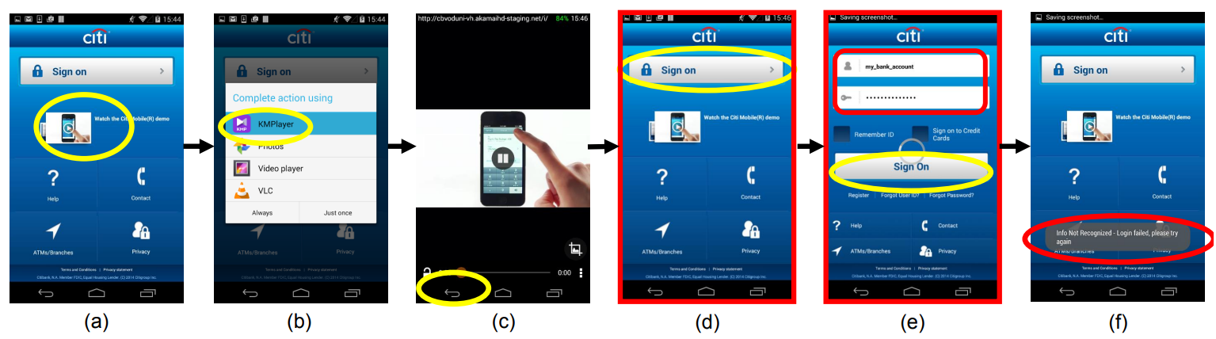
Motivation
Androids UI => popular attack vector for phishing
Tapjacking, Invisible Grit Attack, Cloak&Dagger, …
Task Hijacking
Example:
Example from Ren et al.[1]

Slide 3
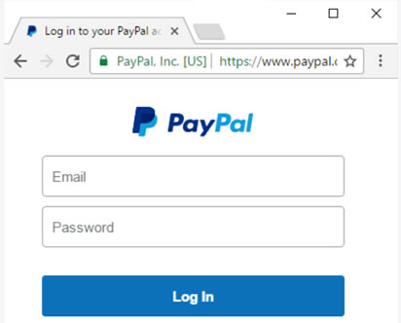

Related Work: Defenses
UI-Confusion => User unable to verify integrity of UI
Security indicators
Browser: HTTPS & EV certificates
Smartphone?
„What the app is that?“[4]
From pkic.org [5]
From Bianchi et al. [4]

Slide 4
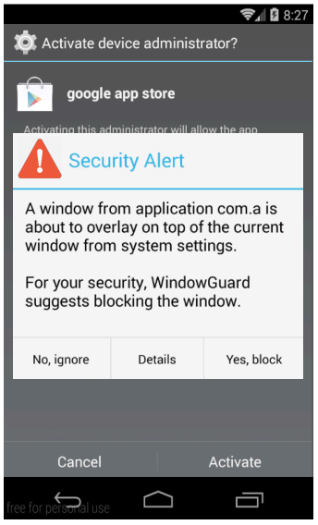
Related Work: Defenses
getRunningTasks
moveTaskToFront
startActivity
Certain APIs are often used for phishing
Static analysis of app‘s to detect malicious uses
False positives?
UI control flow often indicates malicious behavior
WindowGuard[6]:
Dynamic analysis to detect breaches in UI-Integrity
Warn user about a potential breach
From Ren et al. [6]

Slide 5
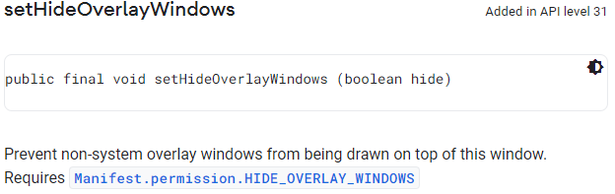
Related Work: Defenses
Android 12 introduced new API:
More control to developers
Choose if specific UI (e.g. login screen) should be treated more securely
Counters overlay-based attacks on UI

Slide 6
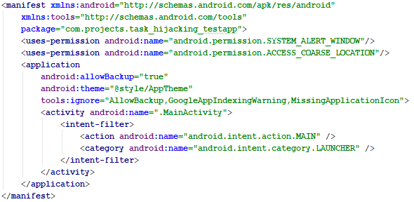
Android Basics
Application Manifest:
Meta-Data of app
Request permissions
Declare components

Slide 7
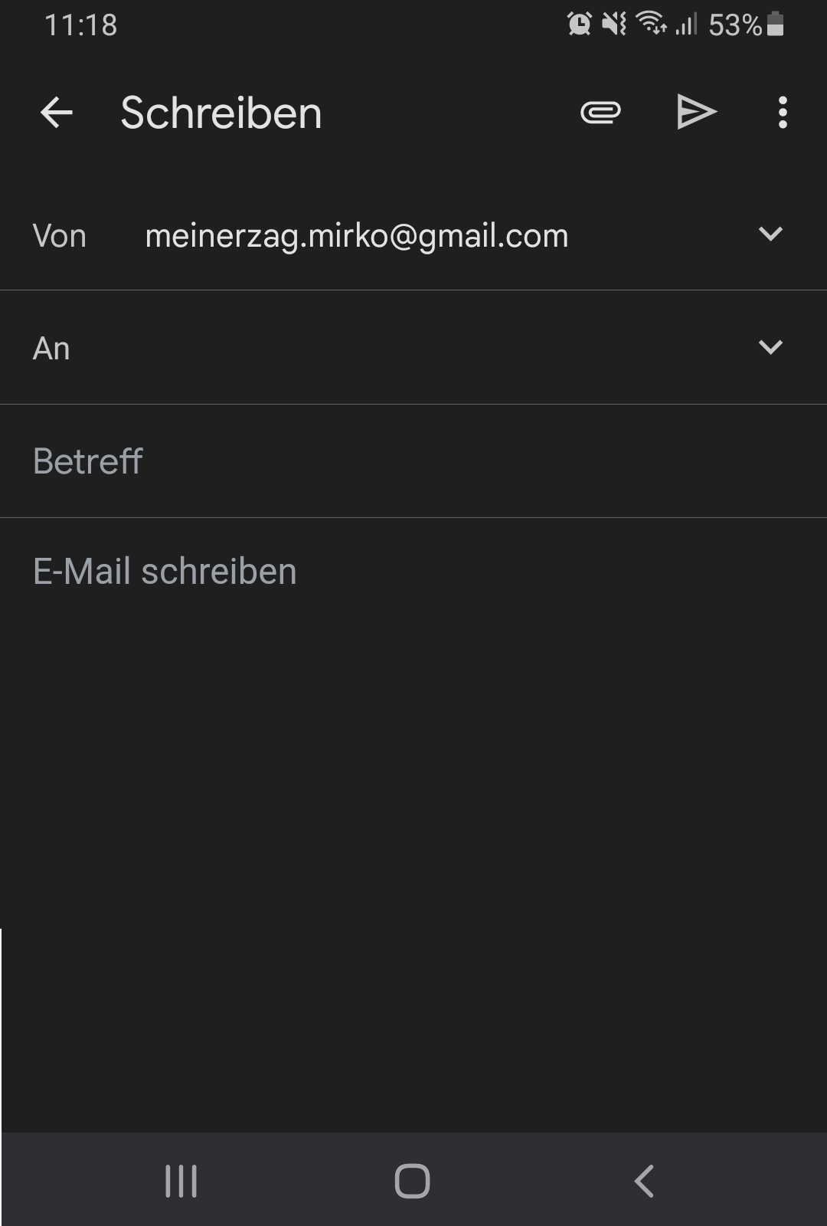
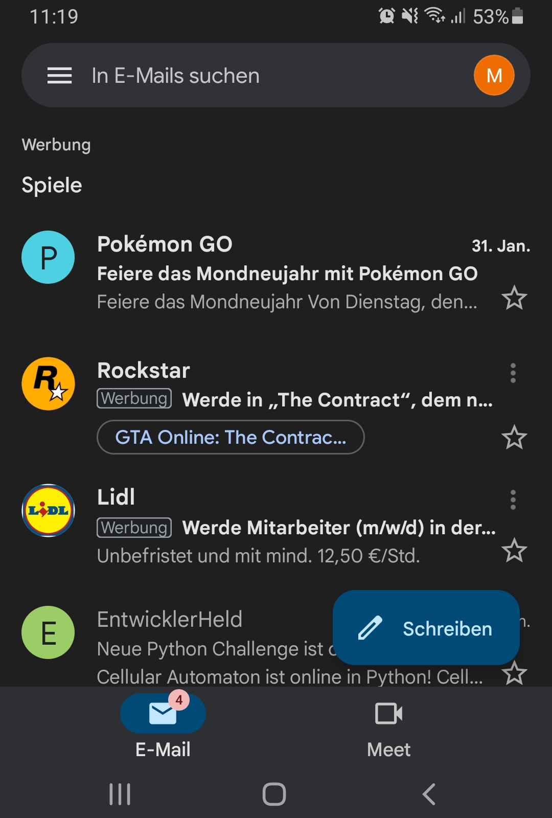
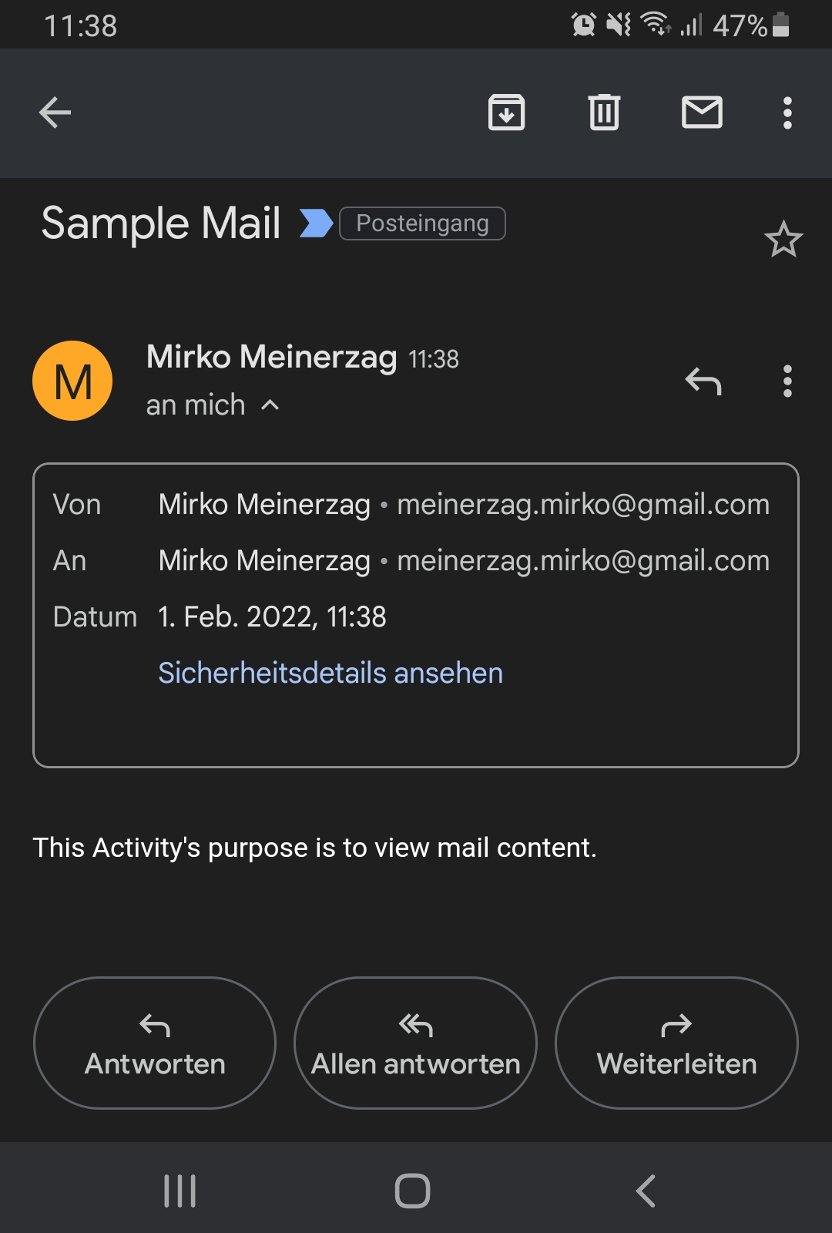
Android Basics
Activity:
Represents a user interface
Typically multiply activities per app
Each designed for a different feature
Launching activity: startActivity(intent)

Slide 8

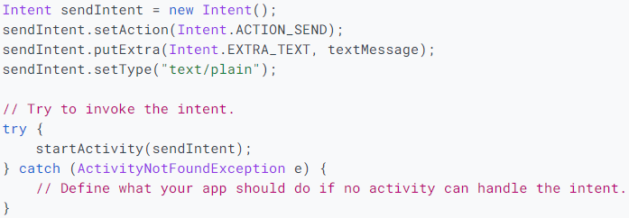
Android Basics
Intent:
Abstract description of operation
Explicit Intent:
Implicit Intent:
VS
Code Examples from Android dev-guide [7]

Slide 9
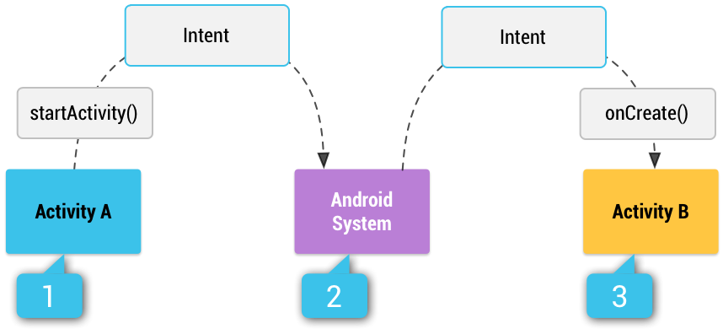
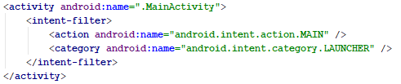
Android Basics
Which activity should be started?
Intent-Filters:
Declared in the manifest
Specifies which intents an app can handle
Multiple apps can handle an intent:
User gets prompted to choose one
Or has already set a default app for the intent
From Android dev-guide [7]

Slide 10
Androids Task Management
ActivityManagerService(AMS):
System service
Manages several components:
Activities
Services
Intent routing
…
One of the most critical system services
Responsible for organizing Activities in Tasks

Slide 11
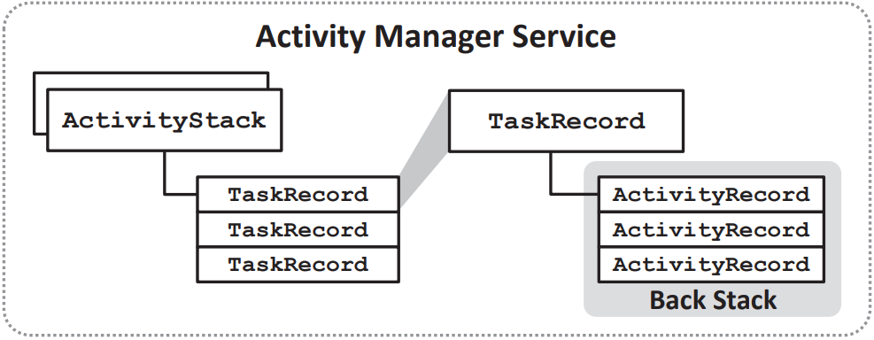
Androids Task Management
Tasks and Back Stack:
Task: Collection of activities
Inside task, activities are pushed onto the back stack
When finished, activities get popped of the back stack
Smooth transitioning between activities via Back-Button
However:
Activities from different apps can reside on same Task
Developers can alter the default behavior of the Task Management
Integrity of UI is in danger!
From Ren et al.[1]

Slide 12
Androids Task Management
Task Control Features:
Default behavior: Activities are pushed onto the task they were started on
Android provides features for developers to change this behavior:
Intent flags
Activity attributes
Intent flags can be set on the intent that starts the activity
E.g. FLAG_ACTIVITY_NEW_TASK, FLAG_ACTIVITY_SINGLE_TOP,…
Activity attributes can be set in the manifest
E.g. allowTaskReparenting, taskAffinity,…

Slide 13
Androids Task Management
Task Transition Model:
Formal model for complex task management
Set of task states
Set of conditions
(S, E, Λ, →)
Set of events
Set of feasible transitions

Slide 14
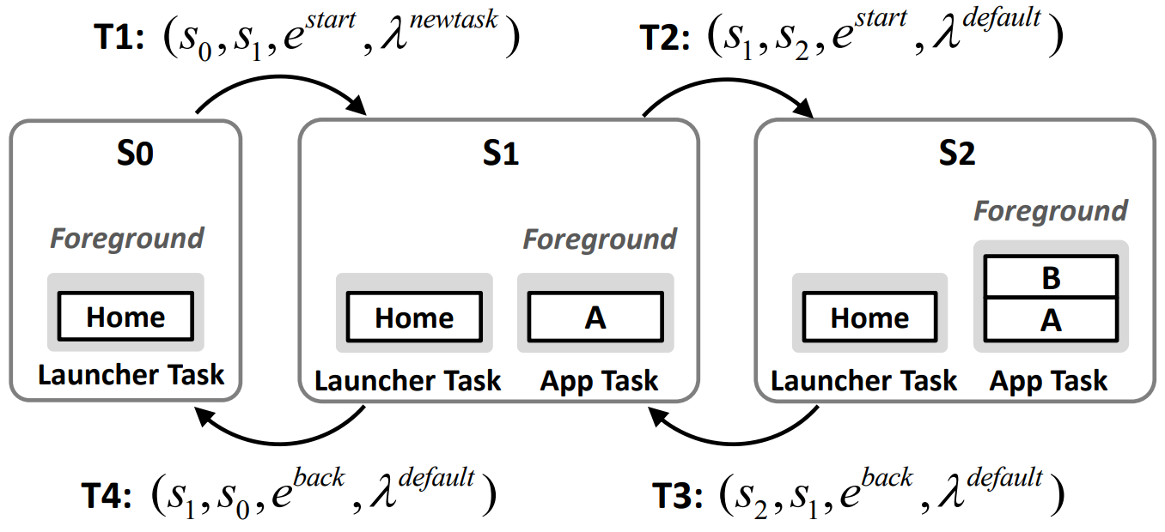
Androids Task Management
(S, E, Λ, →)
Task Transition Model:
Example:
Example from Ren et al.[1]

Slide 15
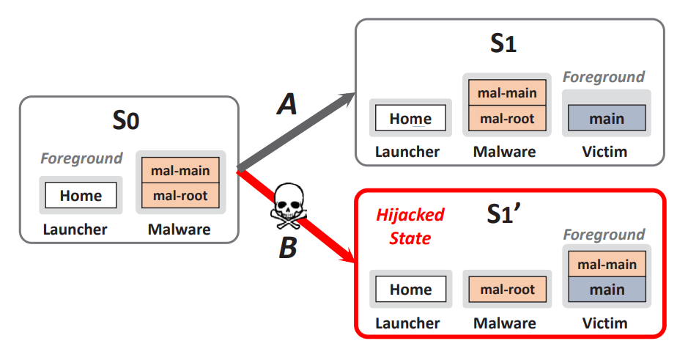
Task Hijacking
Threat model: Malicious application is already installed on the device
General idea: Infilitrate task of victim app with malicious activity
How does one hijack a task?
Abuse task control features
From Ren et al.[1]

Slide 16
Task Hijacking
Two types:
Malicious activity -> victim task
Victim activity -> attacker controlled task
Most relevant task control features:
FLAG_ACTIVITY_NEW_TASK: when set, activity will be launched on different task
taskAffinity: determines which task an activity gets associated with
allowTaskReparenting: indicates whether activity can be reparented to different task
When used in combination, these features can be abused to hijack tasks

Slide 17
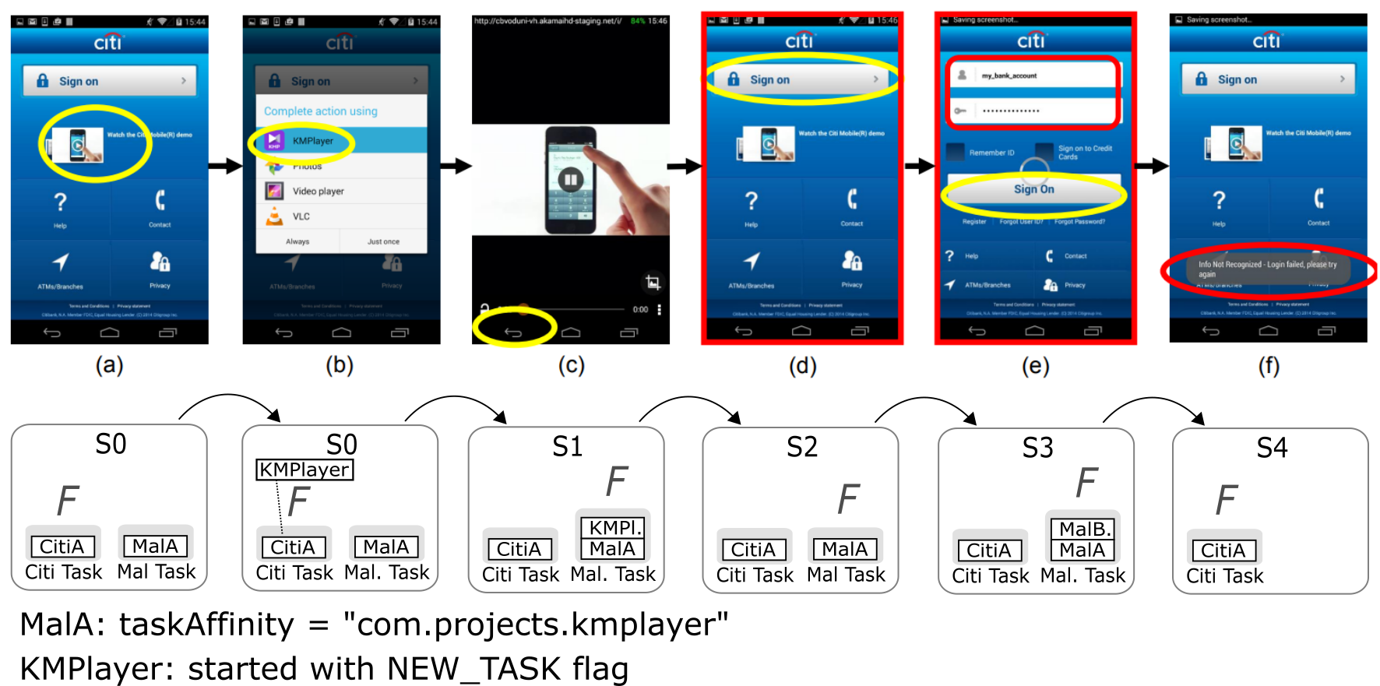
Task Hijacking

Slide 18
Task Hijacking

Slide 19
Task Hijacking

Slide 20
Task Hijacking

Slide 21
Task Hijacking

Slide 22
Task Hijacking

Slide 23
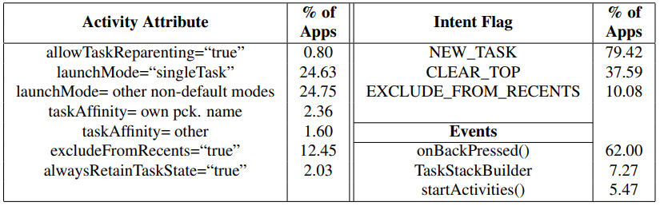

Hardening the Task Management
Disable task control features and sandbox UI?
Usability of many apps damaged
Dynamic/Static app analysis?
Hard to distinguish benign from malicious use-cases
Providing developers with tools to protect their apps?
Developers can choose activities to protect(e.g. login activity)
Similar approach by Google against overlays-based attacks
From Ren et al.[1]

Slide 24
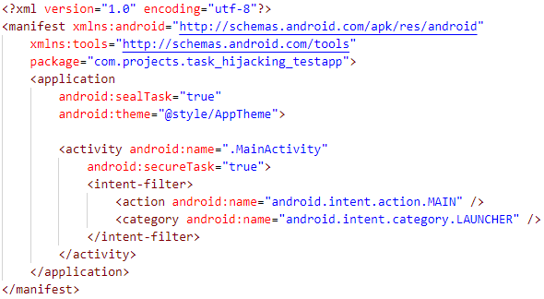
Hardening the Task Management
General idea:
Additional manifest attributes
Protect a sensitive activity
Seal the apps task entirely
New API to protect task/activity at runtime
Dynamically set/remove the secureTask attribute

Slide 25
Hardening the Task Management
Requirements analysis:
sealTask:
taskAffinity of app (i.e. package name) now protected
Other apps can no longer use the taskAffinity of the protected app
Defeats attacks that want to infiltrate victim task
mal-main:
taskAffinity: victim
allowTaskReparenting: true
victim:
sealTask: true

Slide 26
Hardening the Task Management
Requirements analysis:
secureTask:
Activity gets treated differently
Task is sealed during the lifetime of activity
Task transitions that lead to a different task are restricted
Overriding backbutton needs to be overwatched
Prevent attacks that transition to tasks controlled by malware

Slide 27
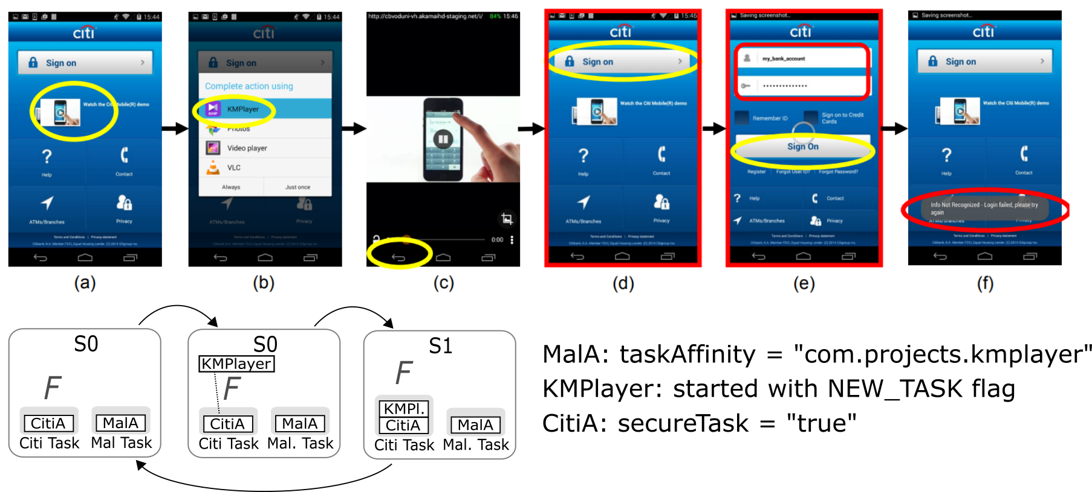
Hardening the Task Management

Slide 28
Hardening the Task Management

Slide 29
Hardening the Task Management

Slide 30
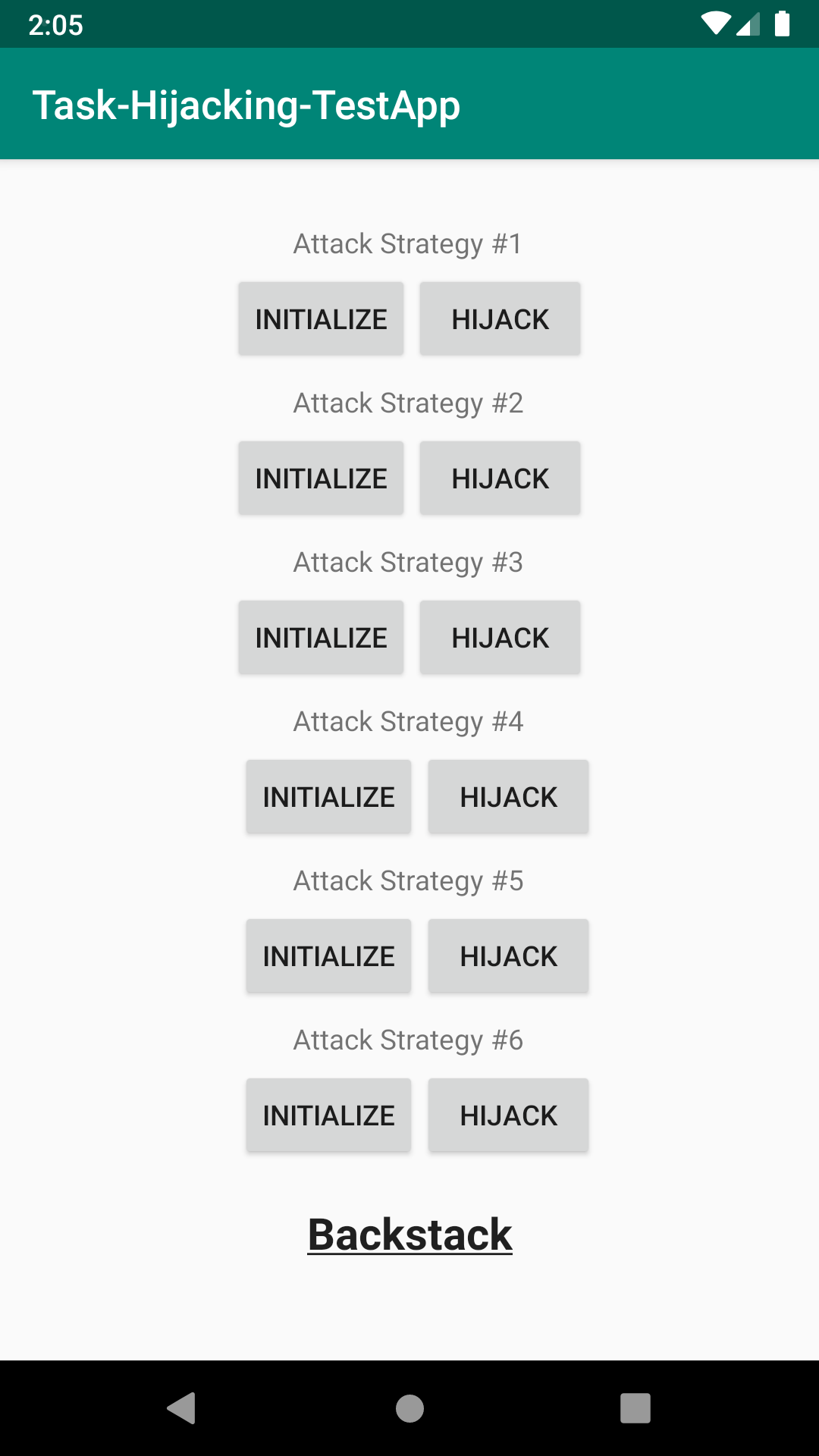

Evaluation
Effectiveness:
PoC-Apps
StrandHogg
Usability:
Benign use-case tests
Performance:
Least priority
Overhead should not impact user experience
Image from [9]

Slide 31
References
[1] https://www.usenix.org/system/files/conference/usenixsecurity15/sec15-paper-ren-chuangang.pdf
[2] https://www.semanticscholar.org/paper/UI-Redressing-Attacks-on-Android-Devices-Niemietz-Schwenk/b05962d6d6510f274a31edfae2c8babee9acaac2
[3] https://www.blackhat.com/docs/us-17/thursday/us-17-Fratantonio-Cloak-And-Dagger-From-Two-Permissions-To-Complete-Control-Of-The-UI-Feedback-Loop.pdf
[4] https://ieeexplore.ieee.org/document/7163069
[5] https://pkic.org/2017/06/06/how-browser-security-indicators-can-protect-you-from-phishing/
[6] https://www.ndss-symposium.org/ndss2017/ndss-2017-programme/windowguard-systematic-protection-gui-security-android/
[7] https://developer.android.com/guide/components/intents-filters
[8] https://developer.android.com/guide/topics/permissions/overview
[9] https://promon.co/security-news/strandhogg/

